Slide 1
STUDYING CURRENT AND PROPOSED PREFETCH ALGORITHMS
SAPTHAGIRI VENKAT RAGHURAMAN
SAI VYSHNAVE KODURU SRINIVASA
SOURAV RANJAN

Slide 2
AGENDA
Introduction
Motivation
Data Prefetching
1. Next-N-Line Prefetching
Instruction Prefetching
1. Next Line Prefetching
2. Wrong- path Algorithm
Correlation Based Prefetching
1. Reference Prediction Table
2. Delta Correlation Table
Prefetching Using Markov Prediction
Implementation

Slide 3
INTRODUCTION
As processors have greatly increased in speed over time, improvements to memory access speeds have been less significant.
This creates a situation in which the processor is frequently waiting long periods of time for the memory system to provide it some data.
Caches are a powerful and commonplace strategy for mitigating this inefficiency, but cache misses still constitute one of the major hindrances on processor performance.
One technique for further reducing memory stalls is to prefetch data that will be needed soon into the cache.
While prefetching is potentially powerful, it must be employed carefully because prefetching data which already resides in the cache or which is not actually needed will degrade performance.
With systems using cache we see if there is a cache miss it imposes a severe penalty on the performance of processor as there are not enough instructions for the processor to execute.
To avoid this situation, processors use prefetching to reduce cache misses which is of two types: instruction prefetch and data prefetch.

Slide 4
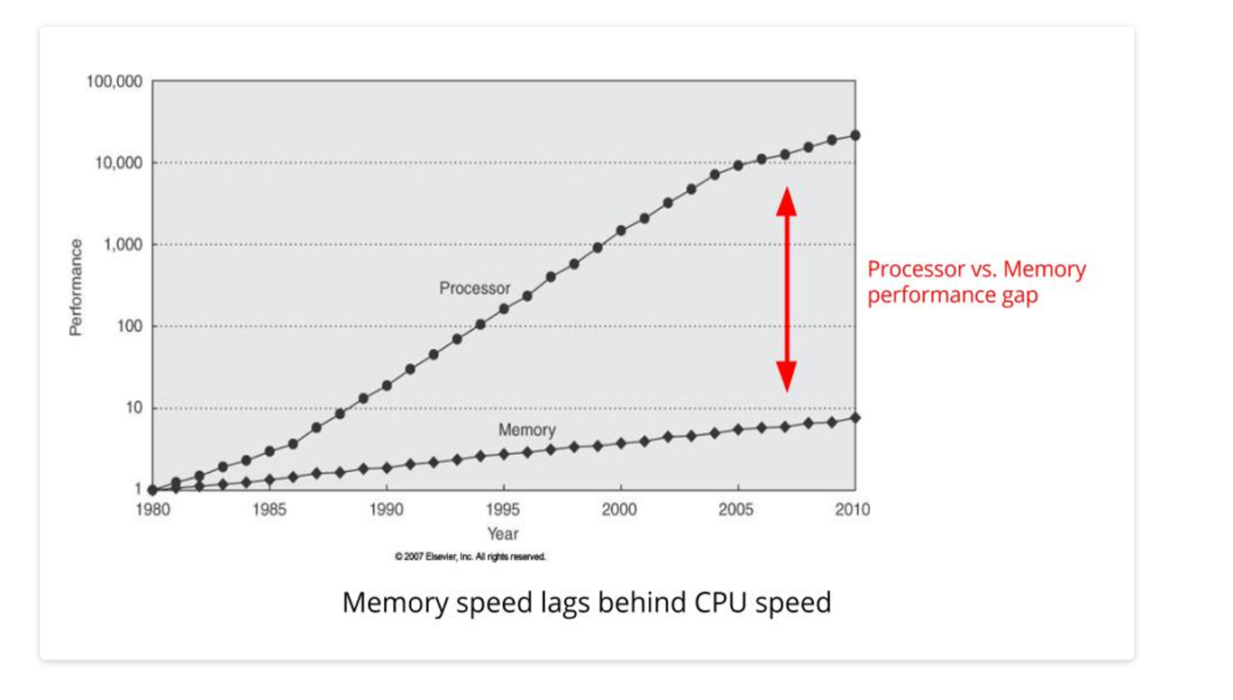
MOTIVATION
Processor performance seems to follow Moore’s Law, increasing by 60% a year, while memory performance increases by just 7% each year.
This was our first motivation for looking for new and effective strategies to reduce the large gap between processor speed and memory speed.

Slide 5
DATA PREFETCHING

Slide 6
NEXT- N- LINE PREFETCHING
For data prefetching, we implemented sequential prefetching, which is a simple hardware-controlled prefetching technique.
It works automatically by prefetching consecutive blocks which follow the block that missed in the cache.
When a miss occurs in the L2 cache, the subsequent K blocks are prefetched to the L2 cache if they are not already there. We will refer to K as the degree of prefetching.
As an example, if we have a miss in the L2 cache for line X, we will first send the request to the RAM.
Then the RAM will service the request for line X and also prefetch lines X+1, X+2, and all subsequent lines until line X+k to the L2 if they are not already there.
The main advantages of this scheme are that it reduces the number of read stalls, it is a simple technique compared with other schemes, and it works well for applications with high sequentiality.
However, the disadvantages are the it doesn’t work as well for programs with frequent branching, it can be more expensive storage-wise, and a larger value of K tends to increases memory traffic and cache pollution because it prefetches data that may not be used if the program execution path is different from the instruction prefetch path.

Slide 7
NEXT- N- LINE PREFETCHING
To implement data prefetching, we need to answer three main questions: what to prefetch, when to prefetch, and where to put the prefetched data.
To answer the first question, if we need to prefetch a request for line X, then we will prefetch X+1, X+2, and all subsequent lines until we reach line X+k.
Secondly, we prefetch when a miss occurs and if the subsequent K blocks are not already in the cache.
To answer the question of “where”, we will prefetch the data from memory and put them in the second level cache, assuming the data is not already there.

Slide 8
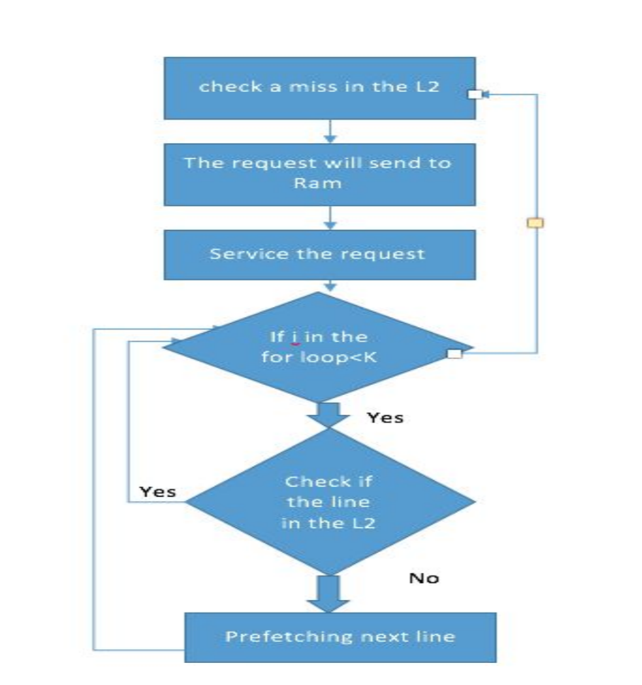
NEXT- N- LINE PREFETCHING

Slide 9
INSTRUCTION PREFETCHING

Slide 10
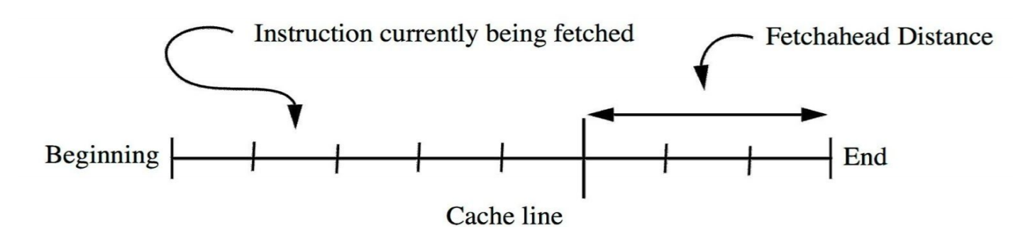
NEXT LINE ALGORITHM
This algorithm tries to prefetch sequential cache lines before they are needed by the CPU’s fetch unit.
The current cache line is the line that contains the instruction that is currently being fetched by the CPU.
The next line is defined as the cache line which is located sequentially after the current line.
This schema works as follows: if the next line is not found in the cache, then it will be prefetched when an instruction located some distance into the current line is accessed.

Slide 11
NEXT LINE ALGORITHM
The fetch ahead distance can drastically affect the performance of this algorithm.
It shouldn’t be too small in case we encounter a branch, and it shouldn’t be too large because we may not be able to bring the data into the cache in time.
Next-line prefetching doesn’t work for conditional branches, as the execution will fall through any conditional branches in the current line and continue along the sequential path.
This algorithm is simple and doesn’t require any extra hardware.
This algorithm is also the basis of the next two algorithms that we will discuss.

Slide 12
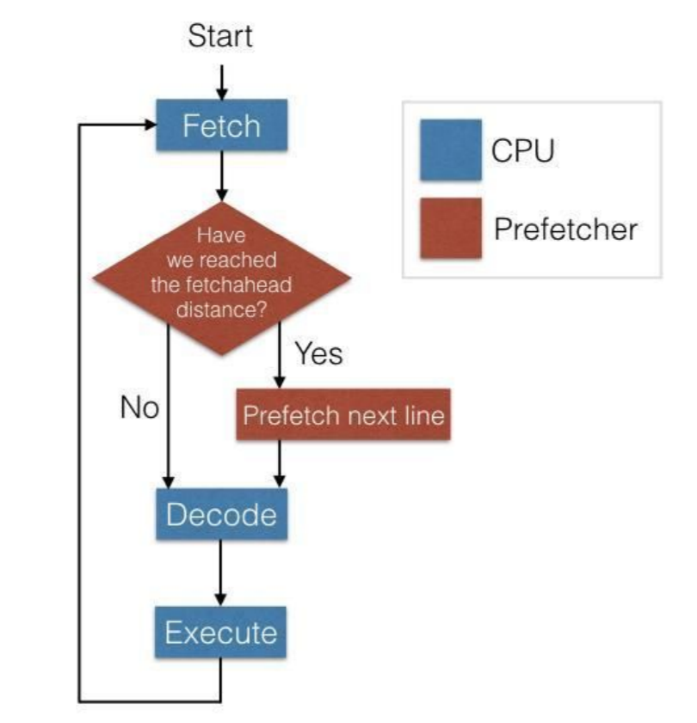
NEXT LINE ALGORITHM
The Next-Line algorithm works by monitoring the CPU for a fetch operation.
When a fetch occurs, the prefetcher checks whether the fetch ahead distance has been reached, and if so, starts prefetching the next line.
The other two algorithms are based off of this algorithm.

Slide 13
WRONG-PATH ALGORITHM
The Wrong-Path algorithm is similar to Next-Line and Target-Line.
Until a conditional branch instruction is encountered, Wrong-Path works just like Next-Line, bringing in the next sequential line once the fetch ahead distance has been reached in the current line.
However, if a conditional branch instruction is encountered during the decode stage of the instruction cycle, the Wrong-Path algorithm prefetches the target of the branch instruction.
Prefetching the target of a conditional branch takes precedence over prefetching the next sequential line.
Prefetching the target of a conditional branch doesn’t bring in the instruction fast enough to be useful for the next cycle if the target branch is taken.

Slide 14
WRONG-PATH ALGORITHM
However, because of temporal locality, this instruction will likely be used again in the near future, and will already be in the cache at that time.
This is why the algorithm is called Wrong-Path; when we start prefetching the target, we want the sequential path to be taken, but hope that the target instruction will be useful in the near future.
The Wrong-Path algorithm monitors the CPU for fetch and decode operations.
On a fetch operation, the Wrong-Path algorithm behaves like the Next-Line algorithm, prefetching the next line if appropriate.
However, on a decode operation, the Wrong-Path algorithm checks to see if the instruction is a conditional branch, and if so, stops any current prefetching operation, and starts prefetching the target of the conditional branch.

Slide 15
WRONG-PATH ALGORITHM
However, because of temporal locality, this instruction will likely be used again in the near future, and will already be in the cache at that time.
This is why the algorithm is called Wrong-Path; when we start prefetching the target, we want the sequential path to be taken, but hope that the target instruction will be useful in the near future.
The Wrong-Path algorithm monitors the CPU for fetch and decode operations.
On a fetch operation, the Wrong-Path algorithm behaves like the Next-Line algorithm, prefetching the next line if appropriate.
However, on a decode operation, the Wrong-Path algorithm checks to see if the instruction is a conditional branch, and if so, stops any current prefetching operation, and starts prefetching the target of the conditional branch.

Slide 16
WRONG-PATH ALGORITHM
However, because of temporal locality, this instruction will likely be used again in the near future, and will already be in the cache at that time.
This is why the algorithm is called Wrong-Path; when we start prefetching the target, we want the sequential path to be taken, but hope that the target instruction will be useful in the near future.
The Wrong-Path algorithm monitors the CPU for fetch and decode operations.
On a fetch operation, the Wrong-Path algorithm behaves like the Next-Line algorithm, prefetching the next line if appropriate.
However, on a decode operation, the Wrong-Path algorithm checks to see if the instruction is a conditional branch, and if so, stops any current prefetching operation, and starts prefetching the target of the conditional branch.

Slide 17
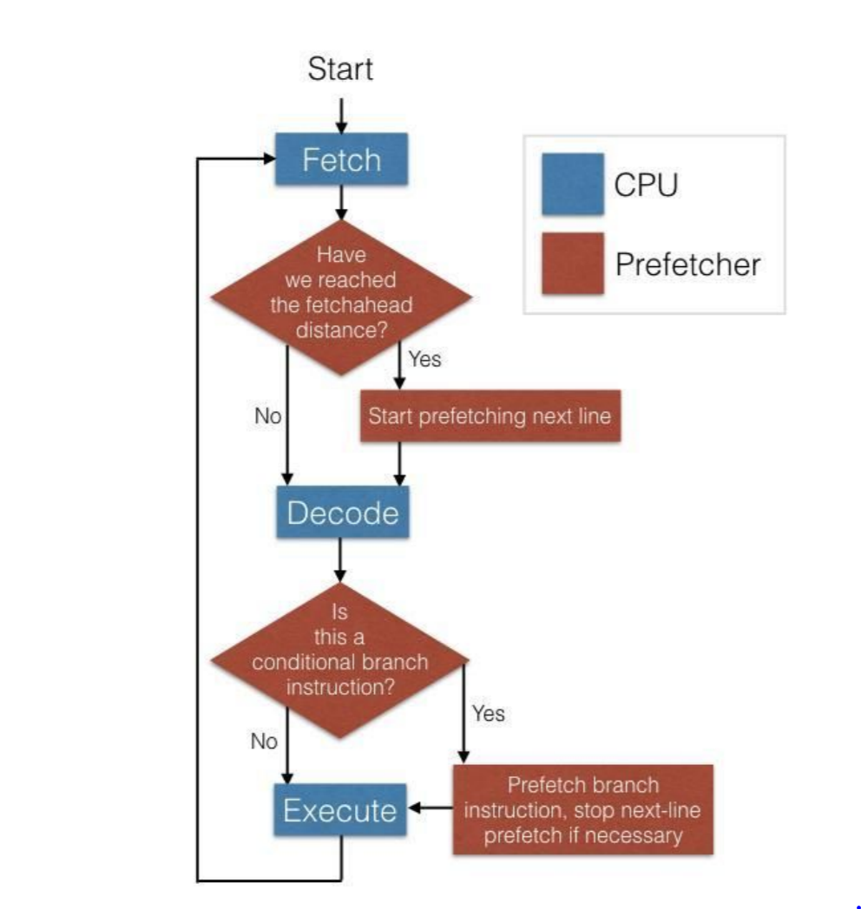
WRONG-PATH ALGORITHM

Slide 18
CORRELATION BASED PREFETCHING

Slide 19
REFERENCE PREDICTION TABLE
Entry?
no
New entry created
Empty table creation
When cache miss
Table is accessed
yes
New prefetch is issued.
Delta of current address=delta of the last address
Last effective address is accessed to calculate the new delta.

Slide 20
Program counter | Last address | delta
One prefetch is issued at a time .
Predicting the cache block can be done one iteration in advance .
Single table entry in RPT
Total number of bits=144
name | type | No.of bits
PC | uint | 64
Last address | uint | 64
delta | int | 16

Slide 21
DELTA CORRELATING TABLE
Program counter | Last address | Last prefetch | Delta1….n
Inspired by RPT and PC/DC prefetching schemes .
Same as the RPT in addition it has last prefetch too.
Entry consists of a circular buffer
Stores n delta values for correlation.

Slide 22
Program counter checks for the corresponding entry in the table.
Entry not found
-new entry is created indexing to the current PC
-Last address is set to the current cache line miss address
- delta between the current and the last address is calculated .
If new delta = 0 then ignore
new delta not equal =0 circular buffer gets updated.
Delta correlating begins after entry is updated
- Backward matching is done to find a striding pattern .
Most recent deltas are compared to find a match .

Slide 23
Do the following steps .
After adding deltas to the prefetching candidates buffer the candidate buffers are compared with
content of the cache
Miss status holding registers
pending buffer which holds the prefetching requests which are not finished.
Candidate is removed from the buffer if the address of the candidate match with an address in any of these locations.

Slide 24
Name | type | No of bits
PC | uint | 64
Last address | uint | 64
Last prefetch | uint | 64
Delta buffer | unit | 64*n
The delta buffer follows the FIFO buffer
The total size of the bits is 576 bits .
DCPT needs 4 times more storage than RPT
-DCPT holds a sequence of deltas for each entry .
-RPT stores only the last calculate deltas.

Slide 25
Prefetching using Markov Predictors

Slide 26
A little Background on Markov Chain
A sequence of trials of an experiment is a Markov chain if:
1. the outcome of each experiment is one of a set of discrete states;
2. the outcome of an experiment depends only on the present state, and not on any past states.

Slide 27
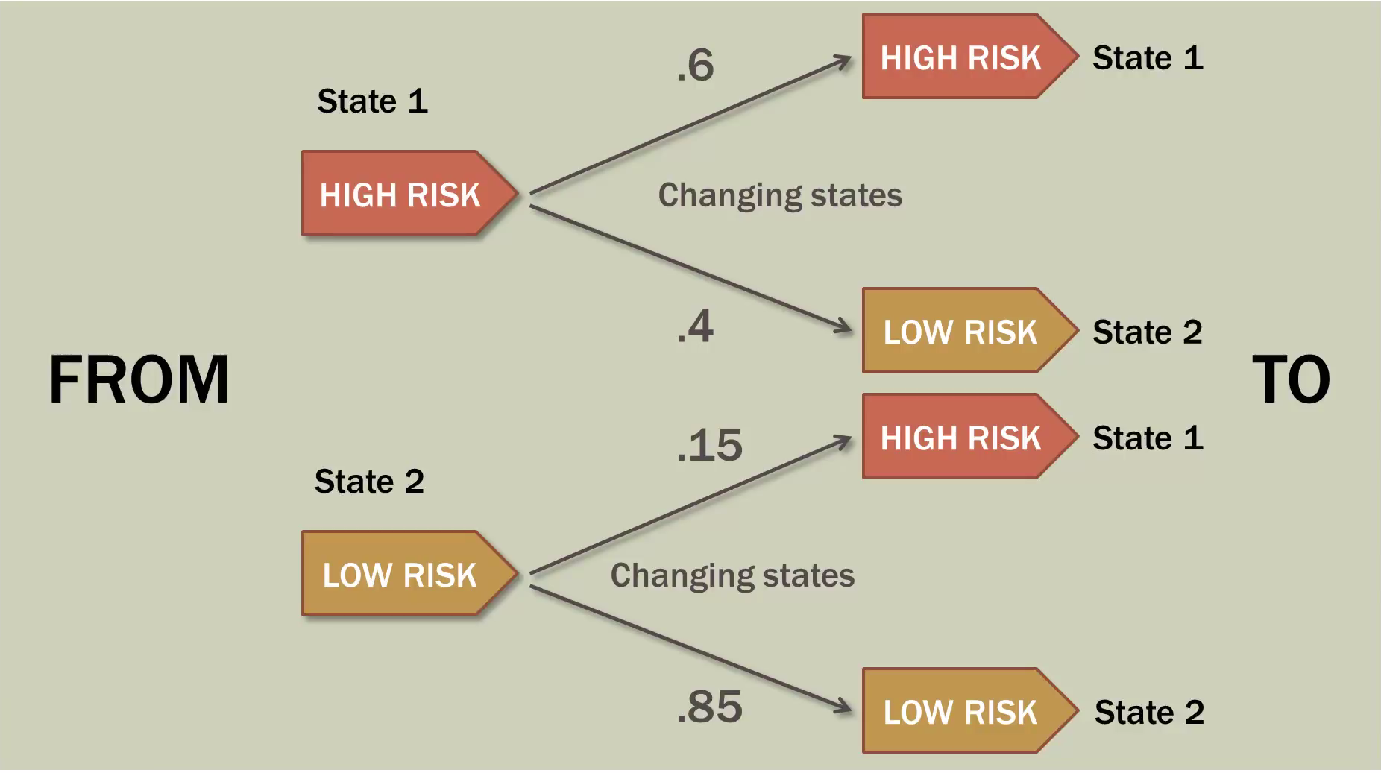
http://www.bcfoltz.com/blog/mathematics/finite-math-introduction-to-markov-chains

Slide 28
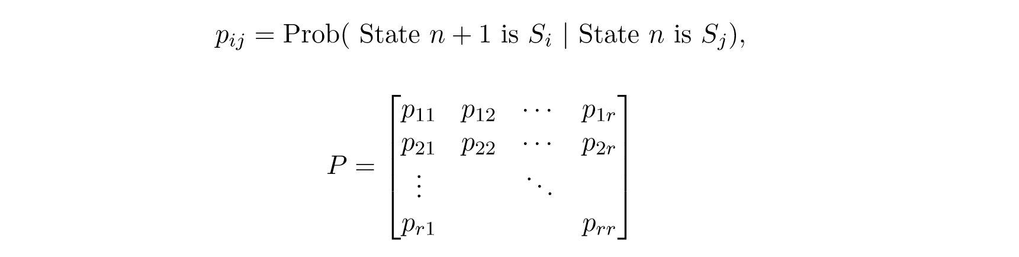
Transition Matrix : contains all the conditional
probabilities of the Markov chain
Where Pij is the conditional probability of being in state Si at step n+1 given that the process was in state Sj at step n.

Slide 29
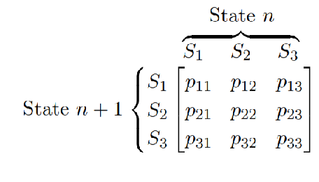
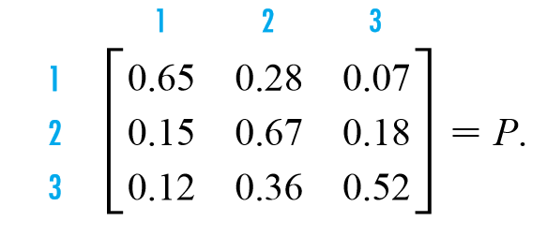
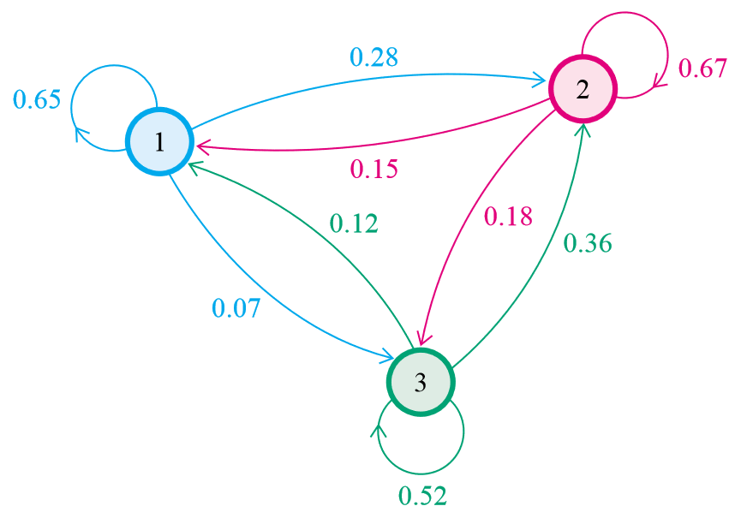
Example:
http://www.math.bas.bg/~jeni/markov123.pdf

Slide 30
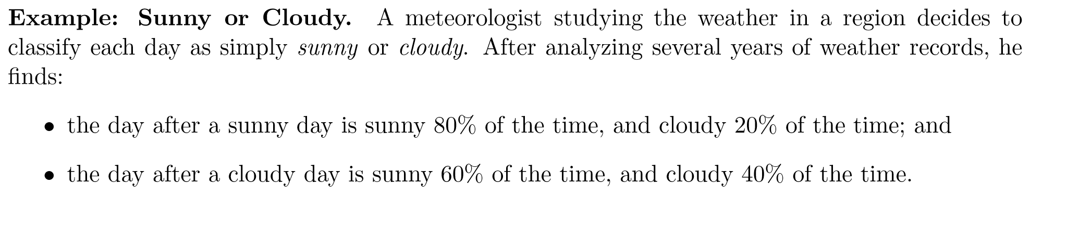
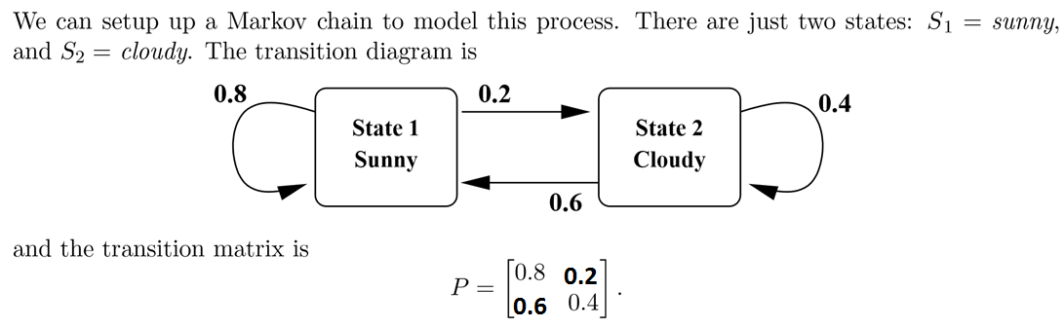

Slide 31
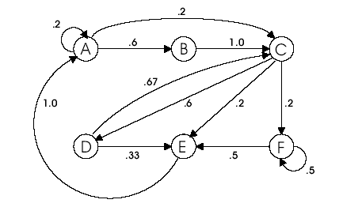
Basic Markov Prefetching
Markov prefetching forms address correlations
Uses global memory addresses as states in the Markov graph
Correlation Table approximates Markov graph
Miss addresses:
A B C D C E A C F F E
A A B C D E A B C D C
miss addr
Predicted addresses
miss 1 | pred 1 | pred 2 | pred 3 | pred 4
… | … | … | … | …
miss N | pred 1 | pred 2 | pred 3 | pred 4
Markov model
Joseph and Grunwald, ISCA 1997
Prefetch queue

Slide 32
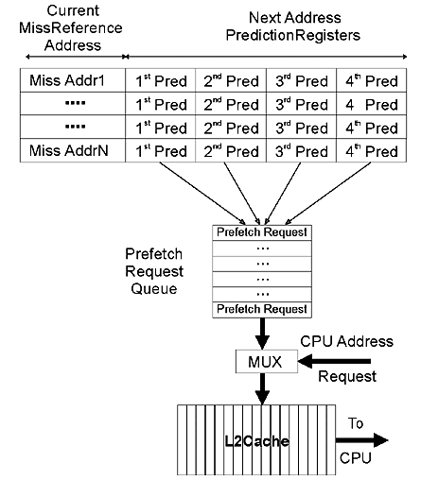
Hardware used for Markov Prediction Prefetcher
Index by current address: table holds 4 possible next addresses
Issue all 4 into prefetch request queue
If queue is full, replace an element with lower priority
LRU prioritization: more recently used has higher priority

Slide 33
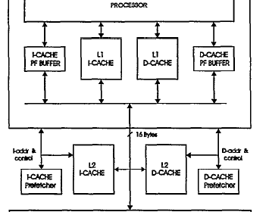
System Design for Markov predictor
Here Prefetch engine is designed as an off-chip component.
I-Cache and D-Cache Prefetch buffers are fully set associative memory placed alongside L1 Cache.
I-Cache and D-Cache Prefetch engine is placed between L1 and L2 cache levels where it can monitor the L1 cache misses to build it’s Prefetch History table.

Slide 34
Disadvantages of using Basic Markov Predictor
The most inherent problem is the large learning phase; it must wait for 2 cache missed for even an entry to be added to the table. Data is not prefetched until one of the missed addressed are not referenced again. This is not good to detect pointer references.
Another problem with the predictor is when to add entries in the prediction table and selection of appropriate number of prediction addresses.
It uses too much bandwidth as for each missed address it sends prefetch request for 4 predicted address on general. And if these predictions are wrong then it will cause more cache pollution.

Slide 35
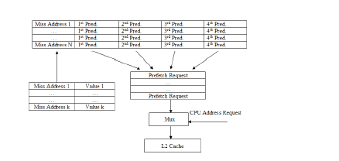
Modifying Markov Predictor with Stride Prefetcher and Pointer Reference Detection

Slide 36
Design of Modified Markov Predictor adding logic for reference predictor
This modified Markov predictor will have original design plus an additional table used to detect pointer references. The goal of the modified design is to limit bandwidth usage by only adding entries to the table when pointer references are detected.
An entry is added to the pointer table when a cache miss occurs. Once the value for the address is known, it is added to the value field in the table. When a cache miss occurs, the predictor checks if the address is the same as any of the value fields. This situation occurs when a pointer is referenced, and the original address is added to the prediction table.

Slide 37
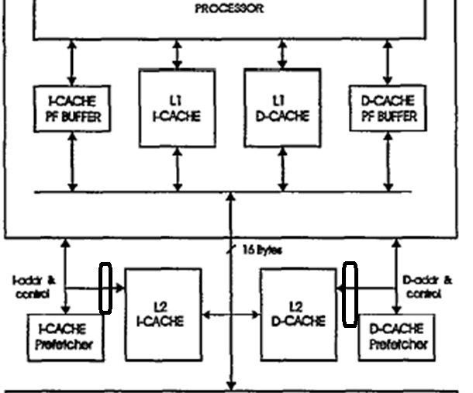
Adding Stride Prefetcher between L2 and Markov Prefetcher
We are going to add a Stride Prefetcher between L2 cache and I-Cache and D-cache Prefetcher.
Since Markov Predictor is bad at finding strides adding a stride prefetcher will improve it accuracy.

Slide 38
Project Implementation

Slide 39
Prefetch Performance Evaluation using gem5
We are going to test these prefetch engines:
Next line prefetcher
Wrong Path prefetcher
Modified Markov Predictor

Slide 40
Gem5 Performance evaluation details
With the gem5 Simulator using
– x86 CPUs
– L1 prefetchers
– Ruby memory system
– MOESI coherency protocol
– Garnet network simulator

Slide 41
Gem5 Simulation System
CPU
L1D
Cache
L1I
Cache
L2 Cache
Prefetcher
Memory Interface

Slide 42
Gem5 Implementation
CPU
L1D
Cache
L1I
Cache
L2 Cache
Prefetcher
Memory Interface

Slide 43
System Setting
CPU: TimingSimpleCPU
 | L1 Caches (Data/Instruction) | L2 Cache
Size | 32 KB | 128 KB
Associativity | 8 | 8
Tag Latency | 2 Cycle | 20 Cycles
Data Latency | 2 Cycle | 20 Cycles
MSHR Size | 16 Entries | 16 Entries
Replacement | LRU | LRU

Slide 44
Gem5 Implementation
CPU
L1D
Cache
L1I
Cache
L2 Cache
Prefetcher
Write Queue
Priority Queue
MSHR
Memory Interface

Slide 45
Bechmark Setting
Prefetcher Configuration
basic PF Types: Baseline
Benchmark:
We will be using SPEC CPU 2006 for benchmarking

Slide 46
REFERENCES
References:
D. Joseph ; D. Grunwald, “Prefetching using Markov predictors”, IEEE Transactions on Computers ( Volume: 48 , Issue: 2 , Feb 1999 )
Ben weber, “Data Prefetching using a modified Markov Predictor ”, “https://pdfs.semanticscholar.org/f135/7c9eb32fcb9858739c46c173ecfb639a69fb.pdf”
Thomas Rosen; Wee-Shong Ong; Jason Upton, “ECE570 Final Paper” “http://web.engr.oregonstate.edu/~benl/Projects/prefetch_report/final.html”

